Slide 1
Simple C Programming

Slide 2
What did we learn?
Declaration / Definition
Data Type
Type conversion
Reference / Pointer
Call by value
Scope rule
Local, non-local
Simple I/O function
printf, scanf
Flow of control
If, switch, for, while..

Slide 3
What did we learn?
Declaration / Definition
Data Type
Type conversion
Reference / Pointer
Call by value
Scope rule
Local, non-local
Simple I/O function
printf, scanf
Flow of control
If, switch, for, while..

Slide 4

Hello world!
gcc –o test test.c
./test

Slide 5
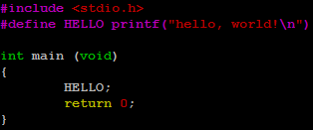
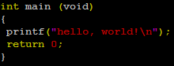
Define / Preprocessed code
gcc –E –o test.i test.c
test.i : Preprocessed code

Slide 6
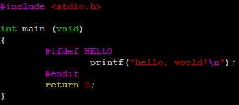
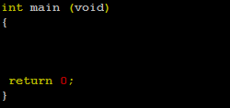
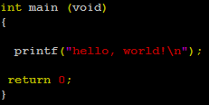
Conditional Compilation
gcc –o test test.c (-DHELLO)

Slide 7
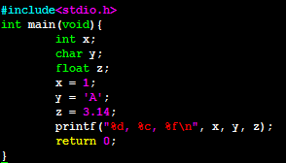
Declaration / Definition

Slide 8
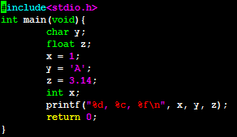

Declaration / Definition
Without declaration

Slide 9
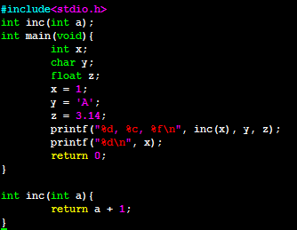

Function
Function declaration

Slide 10
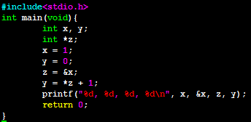

Reference

Slide 11
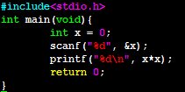
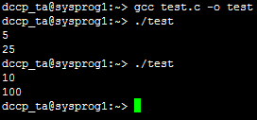
Scanf

Slide 12
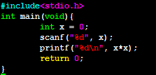

Scanf

Slide 13
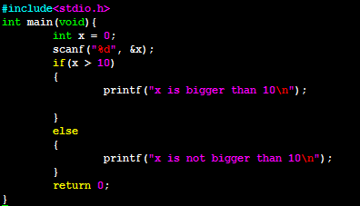
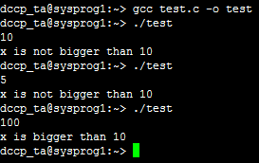
If statement

Slide 14
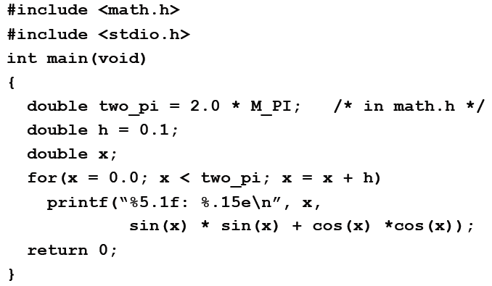
Using math library

Slide 15
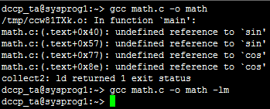
Using math library

Slide 16
Exercise 1
Enter an integer and determine if it is odd.
Print appropriate message for both case
Print message using #define

Slide 17
Exercise 2
Write a program that asks the user to enter the number of hours and then converts that value to weeks, days and hours.
Result example : 2264 hours are 13 weeks, 3 days, 8 hours.

Slide 18
Exercise 3
Write a program that prints a table of trigonometric values for sin(), cos(), tan()
The angles in your table go from 0 to 2π in 20 steps

